Slide 1
RNN
Marlabs

Slide 2
Recurrent Neural Networks
RNN Theory
Basic Manual RNN
Vanishing Gradients
LSTM
Time Series with RNN LSTM

Slide 3
RNN Theory
Examples of Sequences
Time Series Data (Sales)
Sentences
Audio
Music
Let’s imagine a sequence:
[1,2,3,4,5,6]
Would you be able to predict a similar sequence shifted one time step into the future?
[2,3,4,5,6,7]

Slide 4
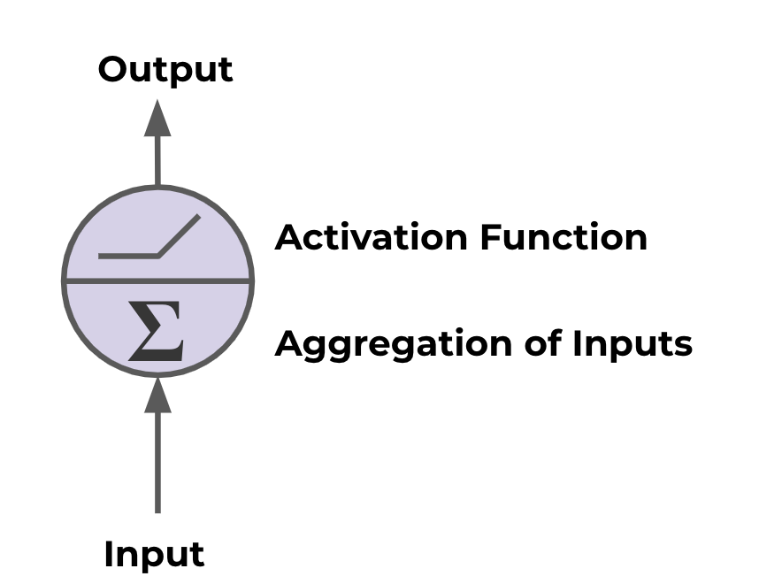
RNN Theory
Normal Neuron in Feed Forward Network

Slide 5
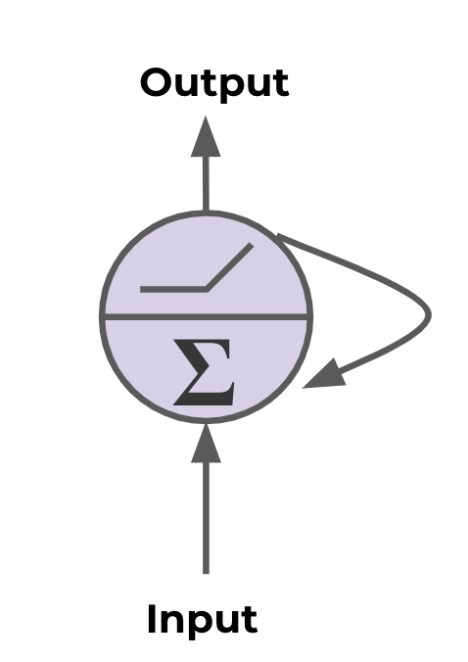
RNN Theory
Recurrent Neuron - Sends output back to itself!

Slide 6
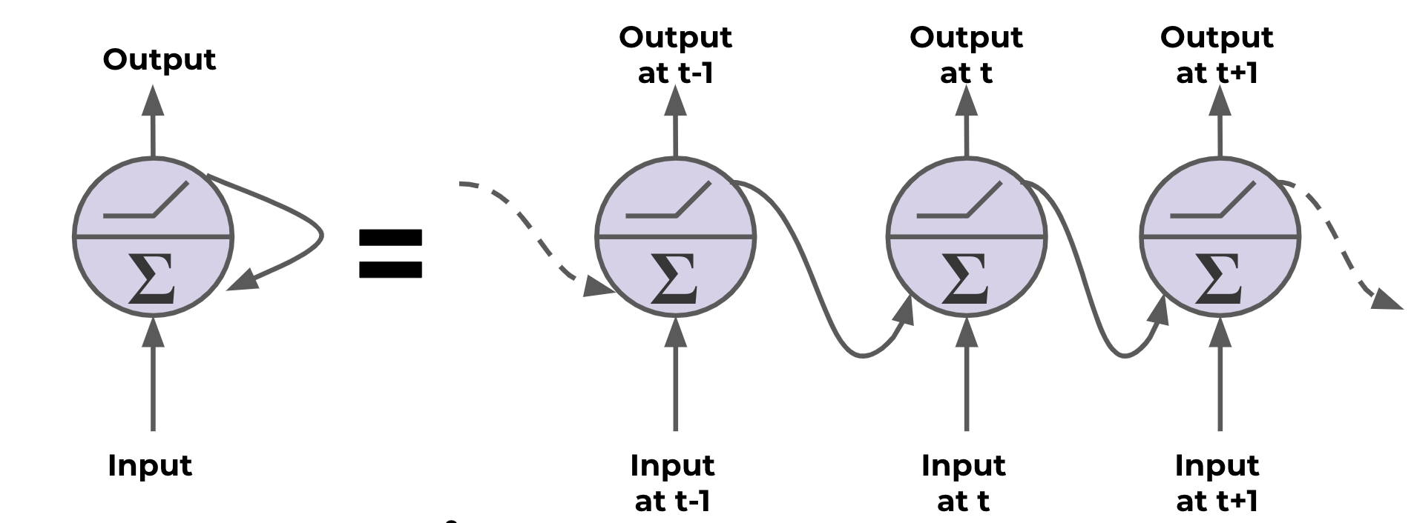
RNN Theory
Recurrent Neuron
“Unrolled” Neuron

Slide 7
RNN Theory
Cells that are a function of inputs from previous time steps are also known as memory cells.
RNN are also flexible in their inputs and outputs, for both sequences and single vector values.

Slide 8
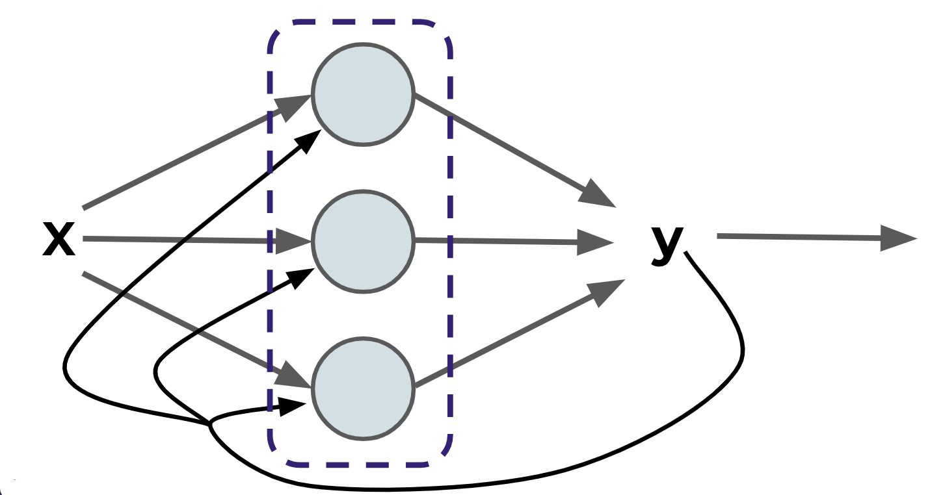
RNN Theory
We can also create entire layers of Recurrent Neurons
RNN Layer with 3 Neurons:

Slide 9
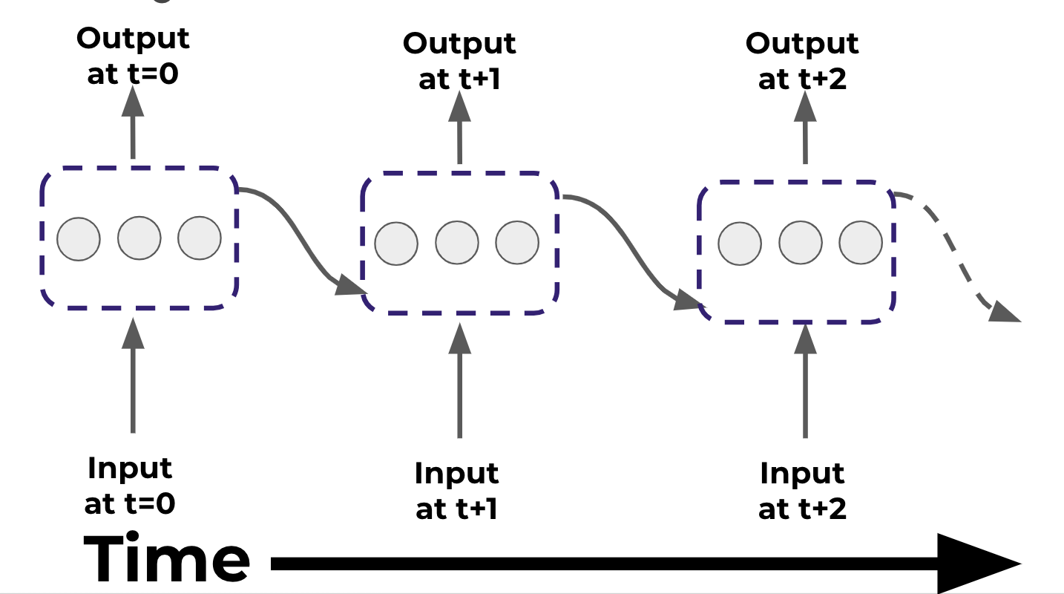
RNN Theory
“Unrolled” layer

Slide 10
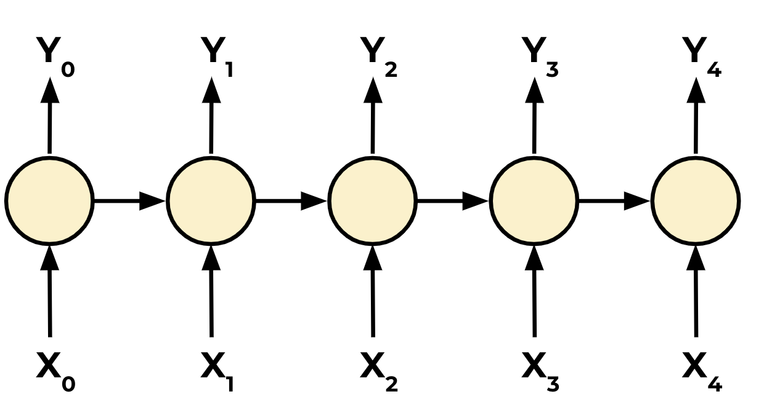
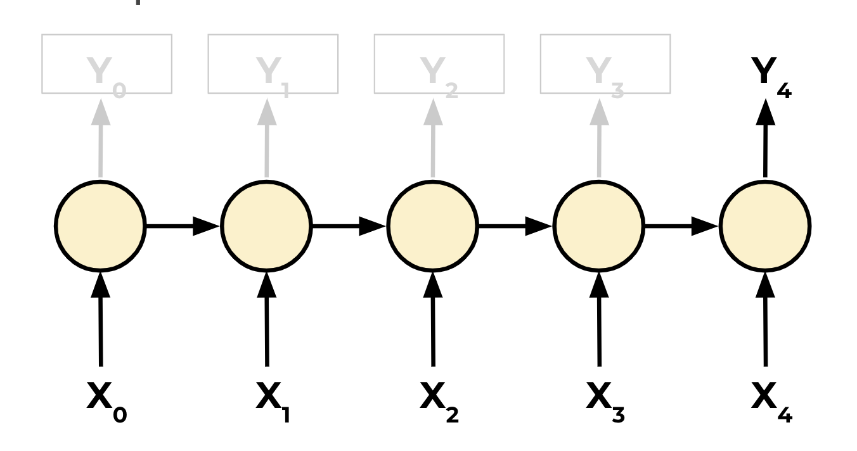
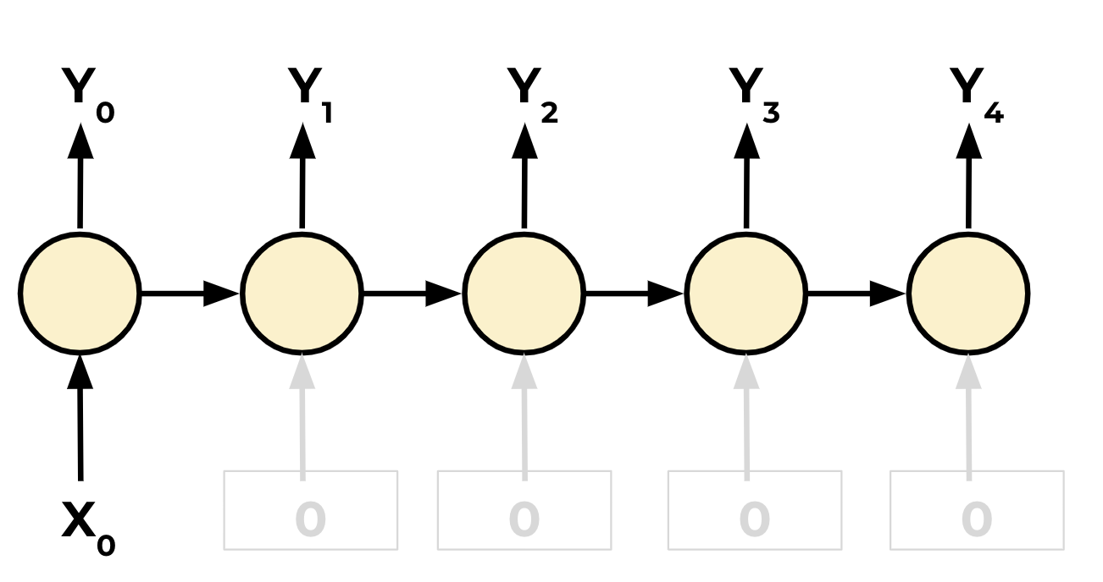
RNN Theory
RNN are also very flexible in their inputs and outputs.
Sequence to Sequence
Sequence to Vector
Vector to Sequence

Slide 11
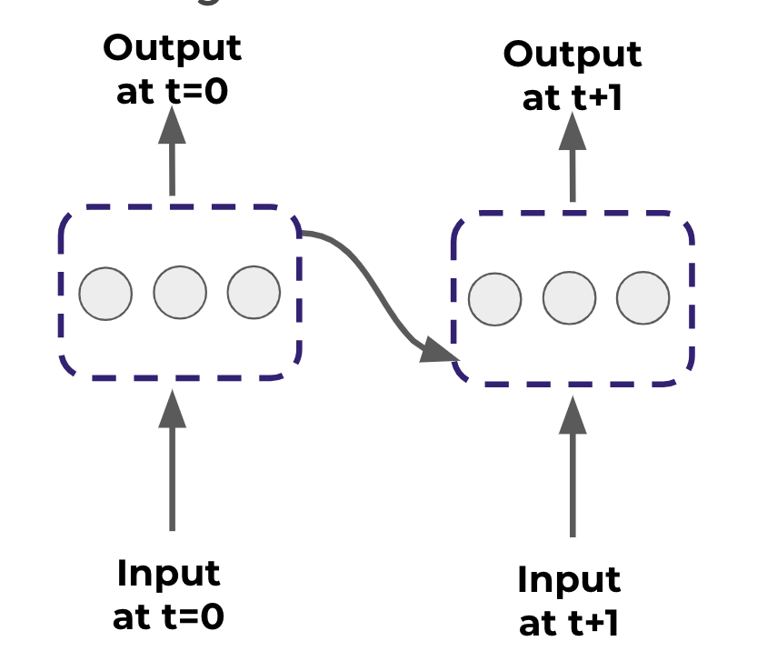
Basic Manual RNN
We will construct the following RNN layer:
“Unrolled” layer:

Slide 12
Basic Manual RNN
We’ll start by running the RNN for 2 batches of data, t=0 and t=1
Each Recurrent Neuron has 2 sets of weights:
Wx for input weights on X
Wy for weights on output of original X

Slide 13
Basic Manual RNN
t=0 t=1 t=2 t=3 t=4
[ The, brown, fox, is, quick]
[ The, red, fox, jumped, high]
words_in_dataset[0] = [The, The]
words_in_dataset[1] = [brown, red]
words_in_dataset[2] = [fox,fox]
words_in_dataset[3] = [is, jumped]
words_in_dataset[4] = [quick, high]
num_batches = 5, batch_size = 2, time_steps = 5

